Slide 1
Loan Eligibility Prediction
Tharika Hansini(DSA_0302)
Machine Learning Foundation Course
Conducted by Dialog Data Science Academy

Slide 2
Introduction
Particular Financial Institution has consumed much time by evaluating a loan approval application when granting a loan facility to a particular customer.
There is a higher risk of evaluating the loan approval process manually and required some automation like loan eligibility prediction in order to select the best customer group with minimum default rate and minimize the human effort applied for loan approval process.
The Ultimate Goal of implementing this Classification Machine Learning Project is to predict whether a certain applicant would have enough capability to repay the loan without any difficulties or not.

Slide 3
Data Collection
The Dream Housing Finance Company has provided the 600 sample applicant dataset with below variables associated in the online loan application form.
The Kaggle Competition Dataset Repository has been used to find the dataset. below is the link to download the related csv file
https://www.kaggle.com/datasets/vikasukani/loan-eligible-dataset
Target Variable (Y)
→ Loan Status
Feature Variables (X)
→ Loan ID
→ Gender
→ Married
→ Dependents
→ Credit History
→ Self Employed
→ Education
→ Applicant Income
→ Co Applicant Income
→ Loan Amount
→ Loan Amount Term
→ Property Area

Slide 4
Methodology
Software
Python Jupyter Notebook
Libraries
Pandas
Seaborn
SKLearn
Exploratory Data Analysis
Below Conclusions have made through out the exploratory data analysis.
Univariate Analysis
81% of the applicants are Males
65% of the Applicants are Married
Around 58% of Applicants have no any dependants
78% of Applicants are Graduates
86% of applicants are not self employed
Most of the applicants are from Semi urban Area

Slide 5
Methodology
Exploratory Data Analysis
Below Conclusions have made through out the exploratory data analysis.
Bivariate Analysis
Graduate applicants have higher chances of being selected for the loan approval.
Applicants with 0 dependents have higher chance of being selected for the loan approval.
Non self employed applicants have higher chance of being selected for the loan approval.
Applicants who have repaid their previous debts have higher chances of being selected for the loan approval.
Married applicants have higher chances of being selected for the loan approval.
Male applicants have higher chances of being selected for the loan approval

Slide 6
Methodology
Missing Value Imputation
Categorical Variables
Missing values has been replaced by mode of the particular variable for categorical variables
Numerical Variables
Median is used to replace the missing values in numerical variables as mean cannot be used due to higher availability of outliers in the dataset for numerical variables.
Outlier Treatments
Log transformation has been applied for avoid the outlier impact for numerical variables and convert the same to normal distribution.

Slide 7
Methodology
Feature Engineering
Below new features have been created in order to build most accurate model.
Total Income = Applicant Income + Co Applicant Income
Monthly Repayment = Loan Amount/Loan Amount Term
Correlation matrix and heat map is constructed and below variables (Applicant Income, Co Applicant income, Loan Amount, Loan Amount Term) have been removed from the dataset in order to get rid of the impact of highest correlation effect before passing the same to Model building process
Label Encoding:
binary variables have used 1,0 replacement and variables which have more than 2 unique values have used the Label Encoder from sklearn package to encoding process of categorical variables in the dataset.

Slide 8
Methodology
Model Building
Train Test Split Function have used and divided the dataset in to train and test sets
→ Test size is 30%
→ Training size is 70%
Model Training Function has used and different Classification algorithms have been used to train the model.
stated below the used algorithms,
→ Logistic Regression
→ Decision Tree
→ Random Forest
Different algorithms with various hyper parameters have been used to train the model and best model has been chosen based on the model evaluation criteria to deploy the solution.

Slide 9
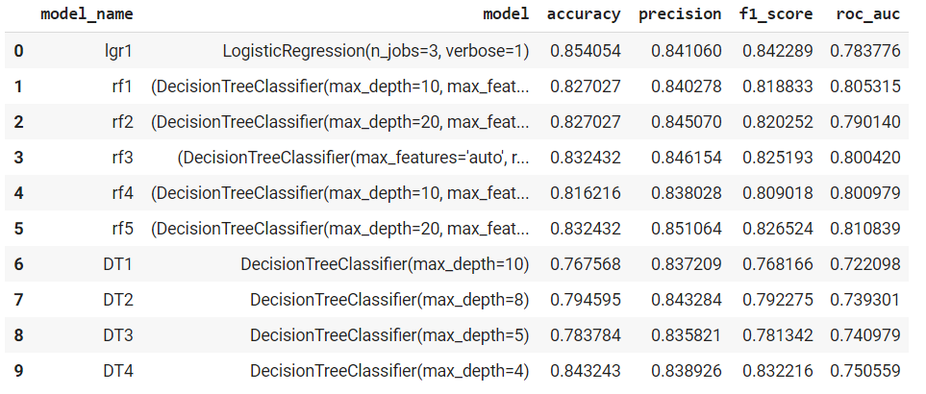
Results
Below are the accuracies of the trained classification models.

Slide 10
Conclusion & Discussion
Model Evaluation
Best Model is the Logistic Regression Model with below accuracy metrics.
→ accuracy = 85.40%
→ precision = 84.10%
→ f1Score = 84.22%
roc_auc = 78..37%
In this project, we learned how to implement a full end-to-end machine learning classification model, selecting its best model with the highest accuracy, to predict which applicants would be good enough to repay the loan.
The logistic regression classification model which predicts the loan status with 85% accuracy has been implemented using 600 sample applicants and their associated features which has available in the online application form.
In addition, some data pre-processing steps, such as adding new features and removing the highest correlated features and applying some coding techniques, were applied to the given raw data set before running the model
This model would save the time allocated to evaluate the eligibility of the loan status as a manual human task done in a particular financial institution

Slide 11
Thank You!

